Slide 1
No Code
Frontend Code Generation using Deep Learning

Slide 2
Inspiration
The process of developing the GUI design implemented by the designer is the task of the developer.
This task however is time consuming and prevents developers from dedicating their time towards implementation of the actual functionality of the product.
Large organizations such as meta and amazon can put big teams to this process, however small organizations and startups may not be able to expend this much manpower to this process.
Hence a system capable of automating this process can not only help such smaller organizations reduce their manpower, but also speed up their development process.

Slide 3
Overview
A web application where the user/developer can upload the screenshot of the UI designed.
A deep learning model capable of generating DSL code from the given input image.
A custom compiler that converts the DSL to the equivalent HTML, CSS and Bootstrap code.
Automated front-end code development can help developers quickly create a prototype of a user interface, saving time and effort.

Slide 4
Implementation
We have attempted to automate this process using deep learning models to generate front- end code for the screenshot of the website design we provide. The model generates code using HTML, CSS and Bootstrap framework
A deep learning model consisting of a CNN encoder and GRU-based decoder is used to generate the target DSL code from a given GUI image.
The DSL code generated is then converted into its equivalent HTML, CSS and Bootstrap code by using a custom-made compiler for the DSL

Slide 5
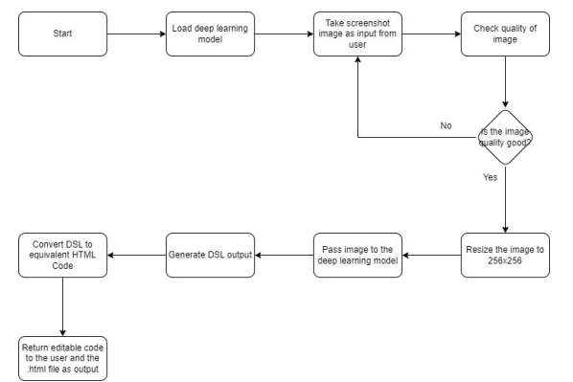
Flow Chart

Slide 6
Future Scope
Since the DSL is being generated by the model so there is always a possibility that the code generated might be syntactically incorrect. Taking measures to address this issue is a possible future extension in the project.
Additionally, increasing the volume of the dataset incorporating newer widgets would help in increasing the accuracy of the model when it is presented inputs different from the images it has been trained on.
This would help the model perform better when presented with current day UI that keeps changing with time.

Slide 7
Thank You

